Slide 2
What is a climate analogue ?

Slide 3
What are the main climate types?

Slide 4
What is a viticultural bioclimatic index?

Slide 5
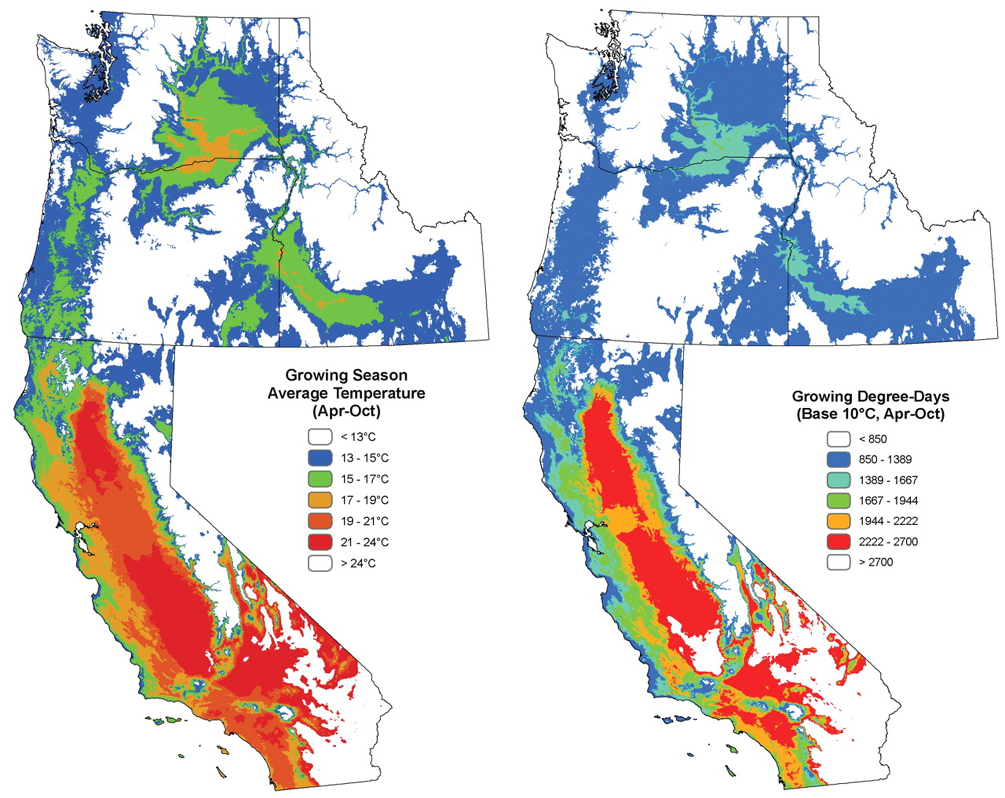
Spatial variation in viticultural potentialities and limitations in Western United States
(Jones et al., 2010)

Slide 6
Can we draw lessons from old world wine regions?

Slide 7
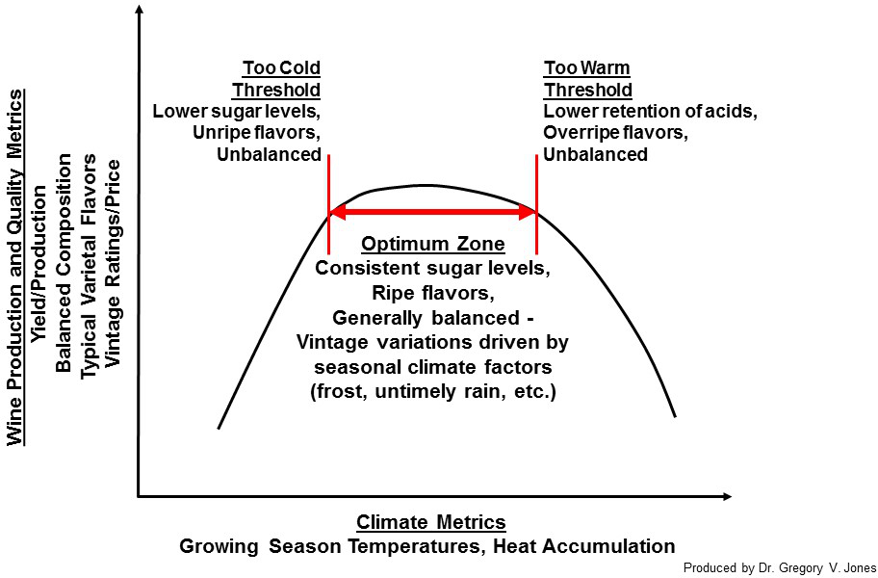
Finding a suitable variety
Timing of ripening is key in the production of high-quality wines

Slide 8
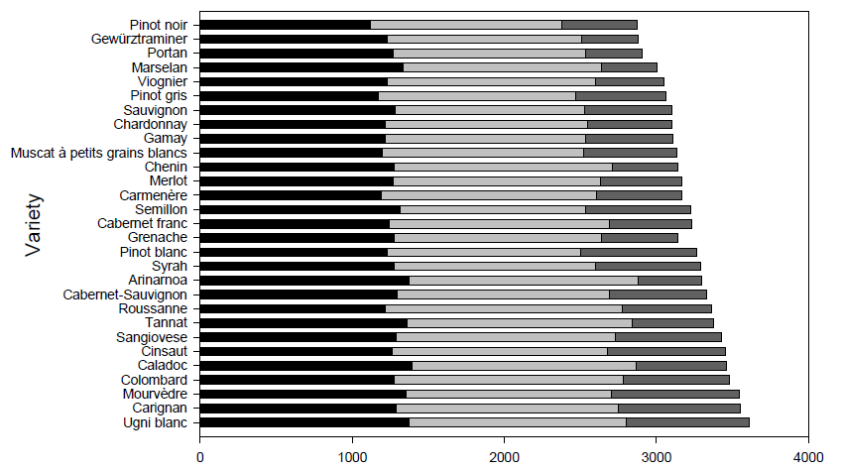
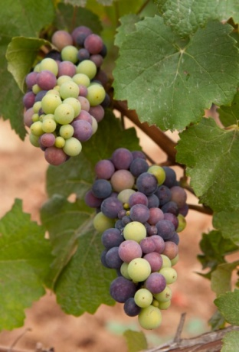
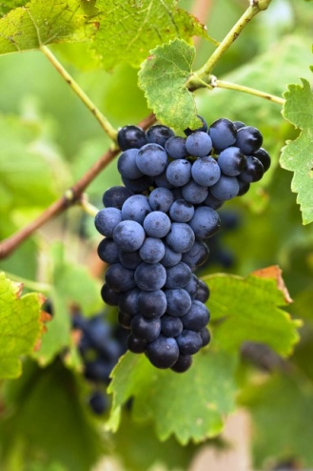
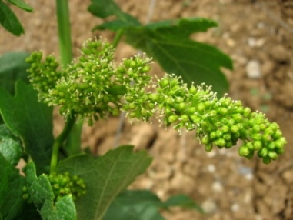
Classification of varieties according to their heat requirements (Parker et al., 2013, 2020)
Veraison
Harvest
Flowering
Heat requirements

Slide 9
What are the challenges with a changing climate?

Slide 10
Climate change in the wine sector
Compelling scientific evidence of an evolving climate → Manifesting through regional warming
While no significant changes are observed in rainfall → Warming has caused less soil moisture, increasing the likelihood of drought
Trend in annual mean temperatures (°C) 1960-2019
Angers
+1.2°C
Warm climate
Bordeaux
Bordeaux
+1.1°C
Temperate climate
Angers
Cool climate
French Wine Regions
Data source : CLIMATIK-INRAE, weather stations in Angers : Beaucouzé and Bordeaux : Villenave d’Ornon

Slide 11
Climate change in the wine sector
Shifting viticultural landscapes → Case of Agroclimatic indices
Very cool
Very warm
Fagnières
Very humid
Fagnières 1971-2000
Avignon
Dryness Index
Avignon 1971-2000
French Wine Regions
Very dry
Huglin Index
Data source : CLIMATIK-INRAE

Slide 12
Climate change in the wine sector
Shifting viticultural landscapes → Case of Agroclimatic indices
Very cool
Very warm
Fagnières
Very humid
Fagnières 1971-2000
Avignon
Fagnières 2001-2023
Dryness Index
Avignon 1971-2000
French Wine Regions
Avignon 2001-2023
Very dry
Huglin Index
Data source : CLIMATIK-INRAE

Slide 13
Climate change related impacts
Advanced phenology and modified berry composition are observed under warmer growing conditions
Extreme weather events as spring frosts or summer droughts are also at the centre of the economic stability of wineries, influencing production volumes
Trends in sugar content (g/L) and total acidity (g/L, H2SO4) on 15 September for a network of Chenin blanc vineyards in Anjou from 1981 to 2021
Anjou
French Wine Regions
Sugar content (g/L)
Total acidity (g/L)
Data source : ATV 49

Slide 14
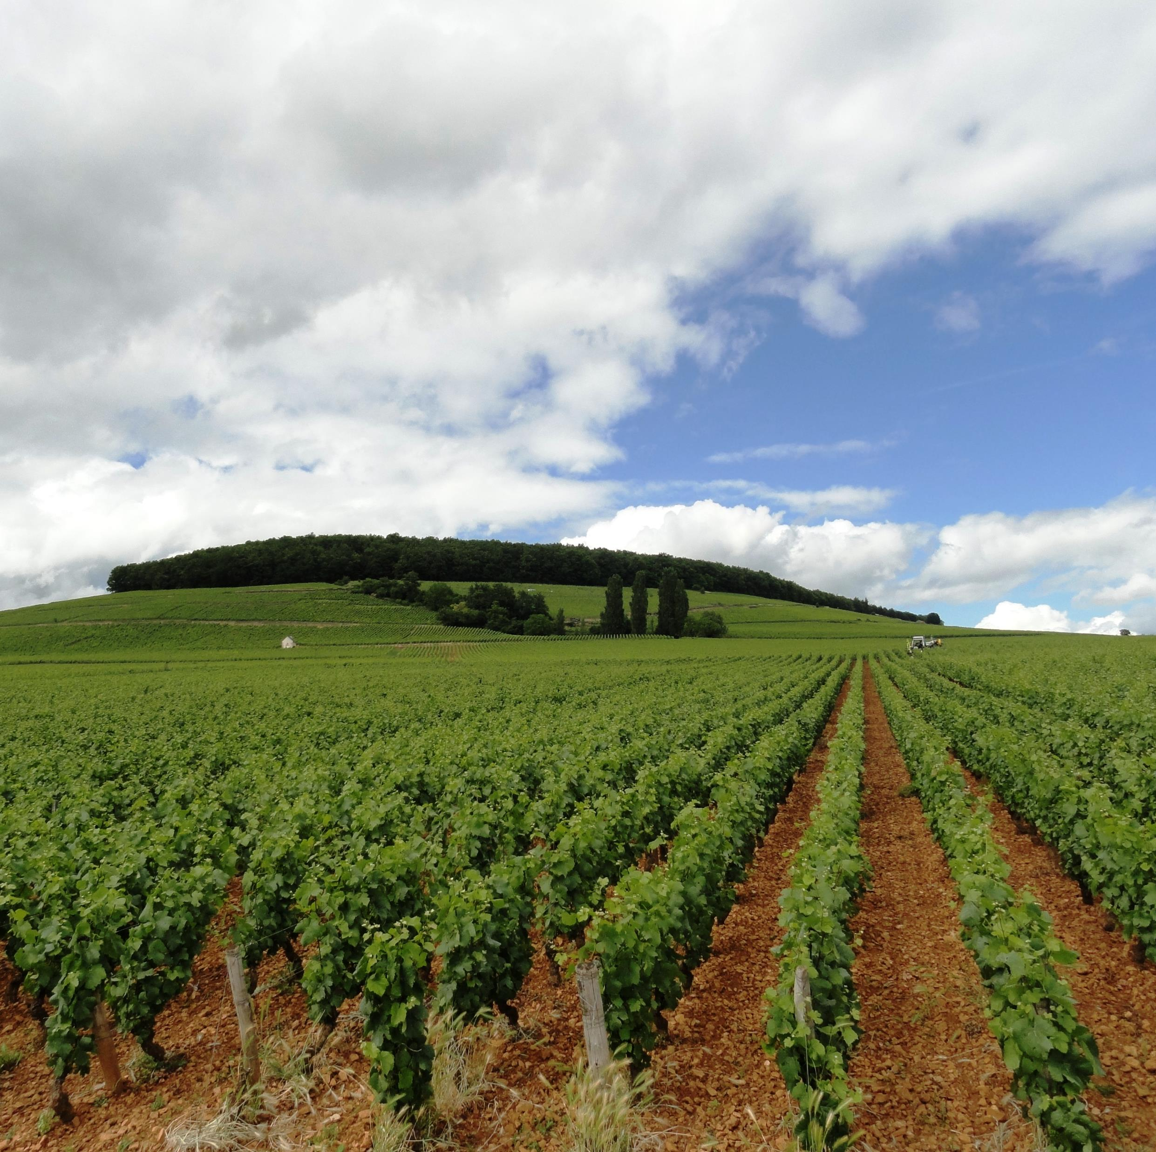
How can we understand future impacts?

Slide 15
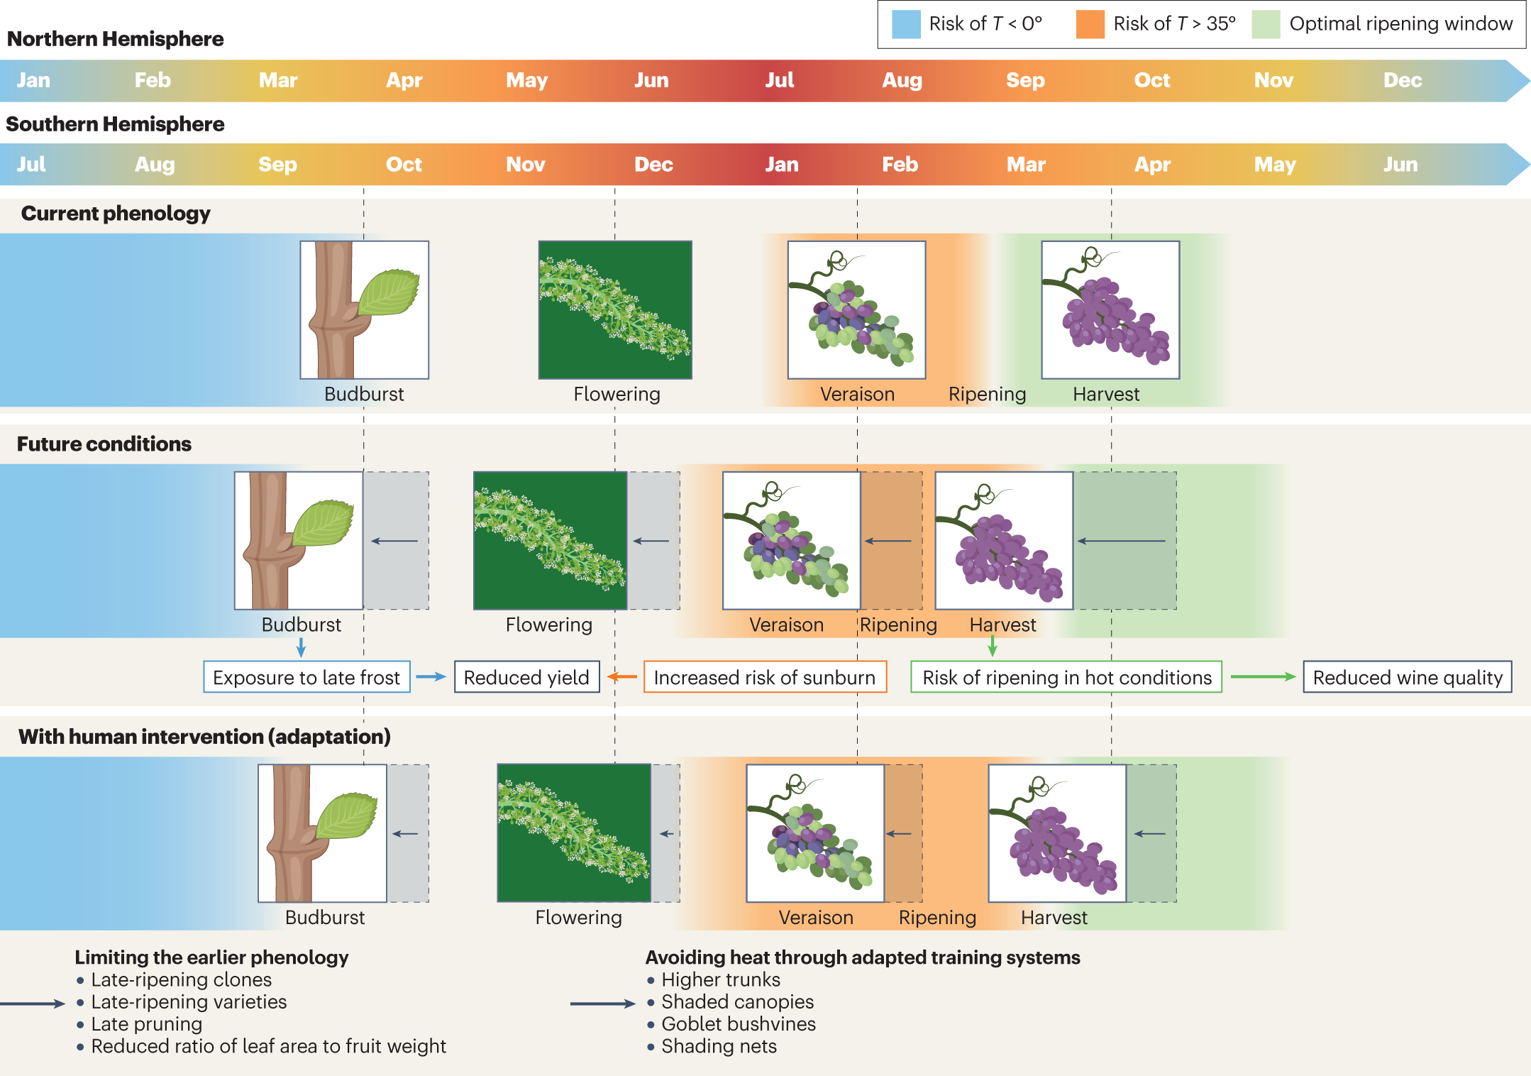
Climate change impacts and adaptations of wine production (Van Leeuwen et al., 2024)
Timing of phenology is key in the production of high-quality wines

Slide 16
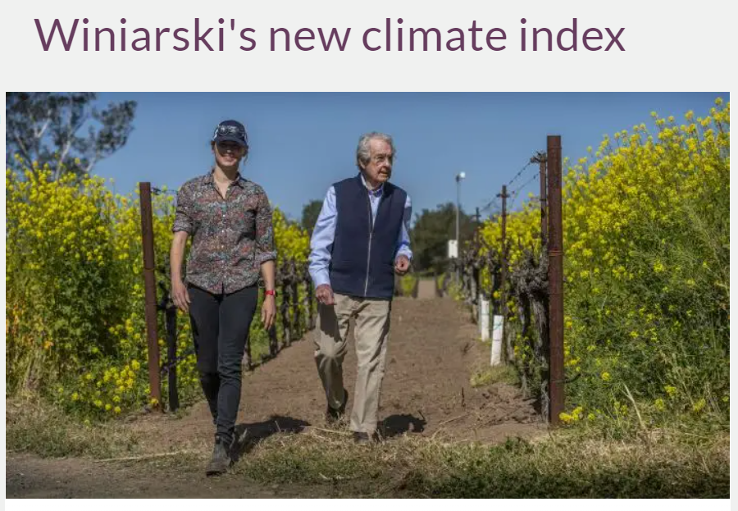
Do we need to review bioclimatic indices ?
Winiarski has donated more than $450,000 toward The Warren Winiarski Fund for Advancing the Amerine-Winkler Index
https://caes.ucdavis.edu/news/taking-climate-change-vineyards
www.jancisrobinson.com/articles/winiarskis-new-climate-index

Slide 17
Can we draw lessons from new world wine regions?

Slide 18
Jan van Riebeeck’s famous diary entry of 2 February 1659
Notes:
1659 – “Today , praise be to God, wine was made for the first time from Cape grapes...” Jan van Riebeeck’s famous diary entry on 2 February of that year. Out of all of the world’s wine-producing nations, South Africa is unique in knowing the exact date on which the wine industry began, thanks to this entry.

Slide 19
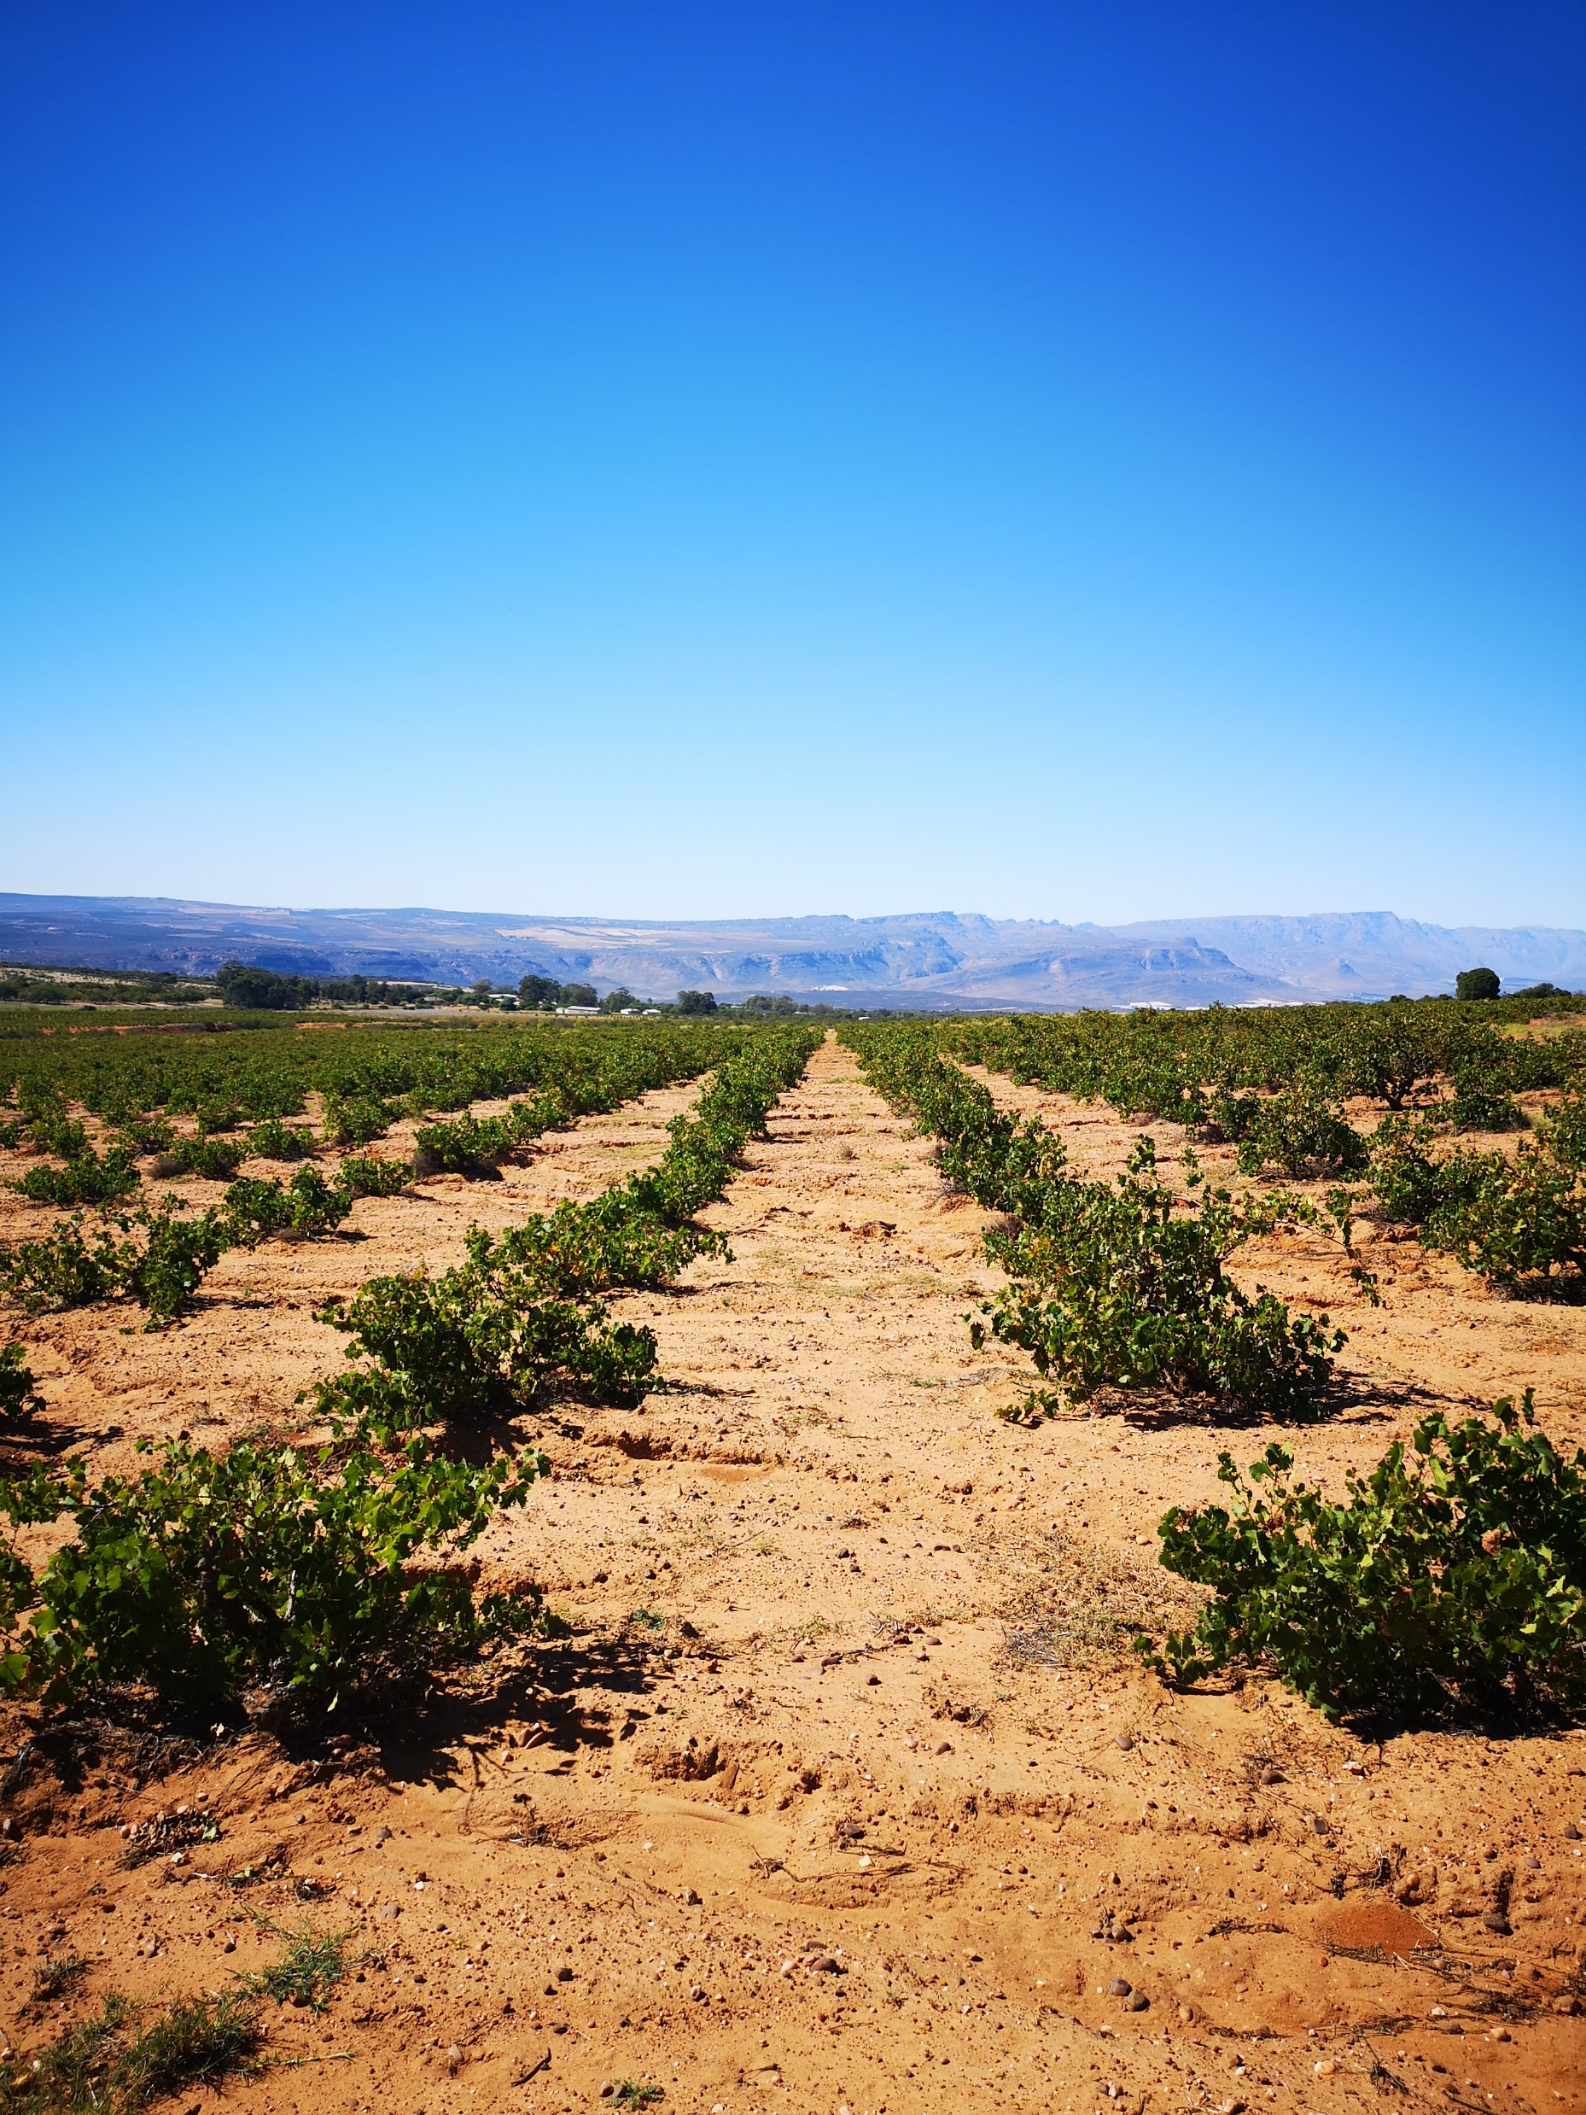
Global geography of Chenin
Chenin blanc in South Africa acting as a climate analogue for the Loire Valley ?
Climate of Angers,
Loire Valley
Annual T: 11,7
Seasonal T: 15.4
Annual P: 636mm
Seasonal P: 340mm
Climate of Stellenbosch, South Africa
Annual Temp. 16.5°C
Seasonal Temp. 18.9°C
Annual Prec. 680mm
Seasonal Prec. 189mm
SA Atlas of Climatology
R.E. Schulze, 2009

Slide 20
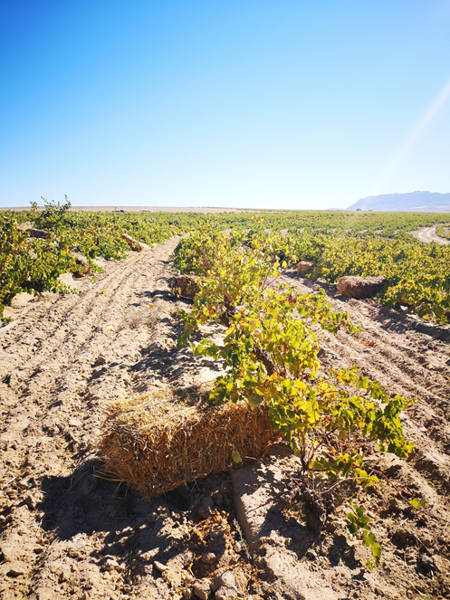
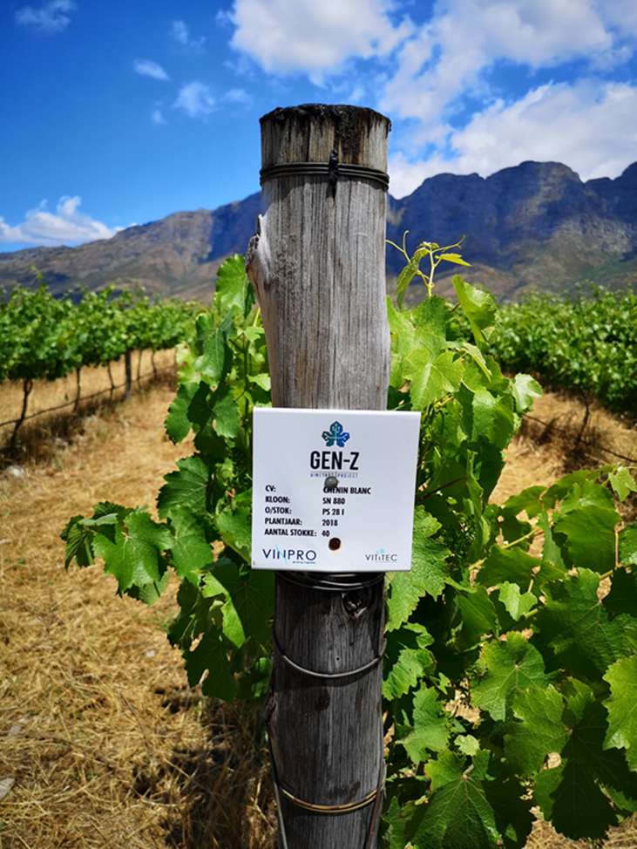
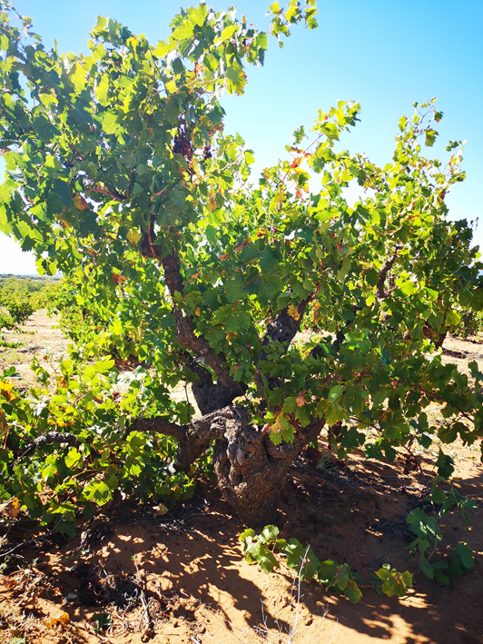
Farming lessons from South Africa
Soil water management
GEN Z project
Old vine project

Slide 21
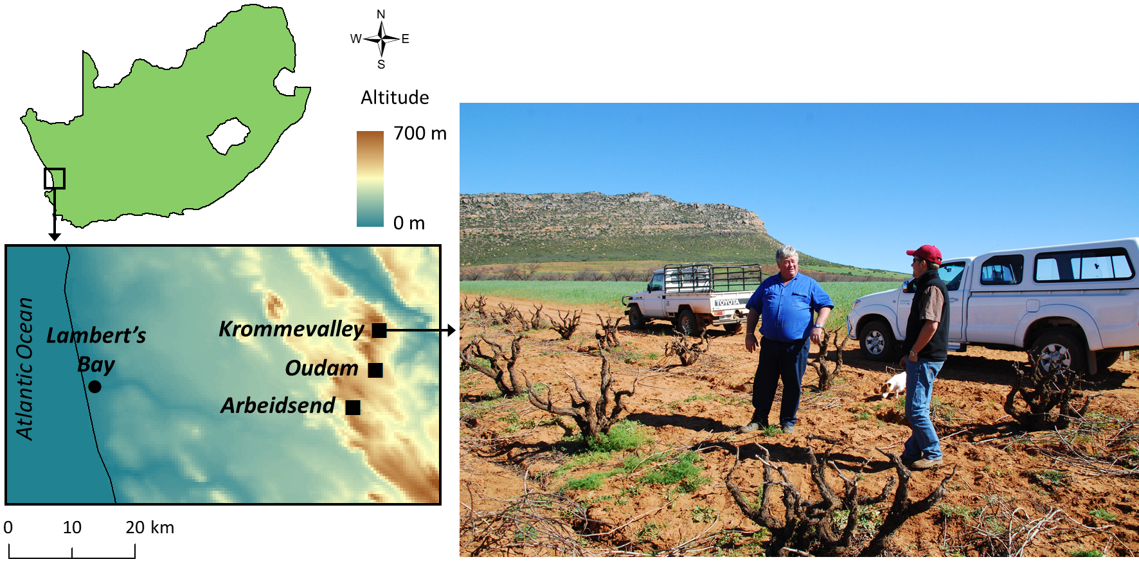
Common garden experiments
Could the Skurfberg old Chenin vines be the saving grace of Loire Valley wine identity?
Published at https://www.jancisrobinson.com/articles/wwc21-skurfberg-south-africa

Slide 22
Are there winners and losers with climate change?

Slide 23
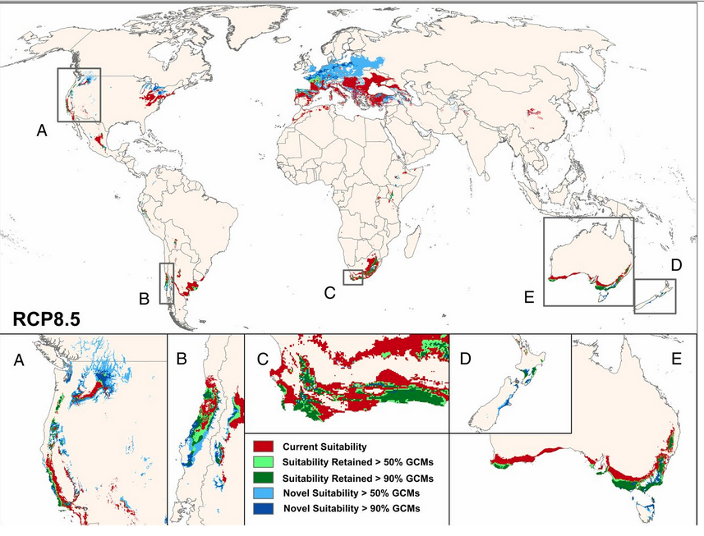
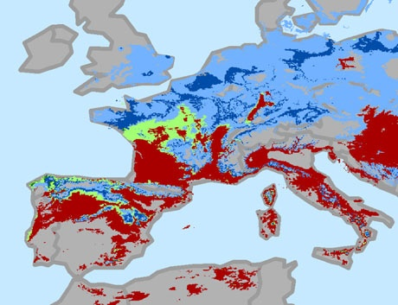
Climate change is expected to alter significantly the geography of wine producing regions (Hannah et al., 2013)

Slide 24
Exemple of Okanagan Valley, Canada

Slide 25
Increased Weather/Climate Variability
Arctic amplification (4x the rate of warming of the rest of the planet) has produced a slower jet stream, with more amplified north-south waves, more extreme weather and greater swings in climate conditions from year to year, season to season, and month to month. Some indication of similar changes in the Southern Hemisphere

Slide 26
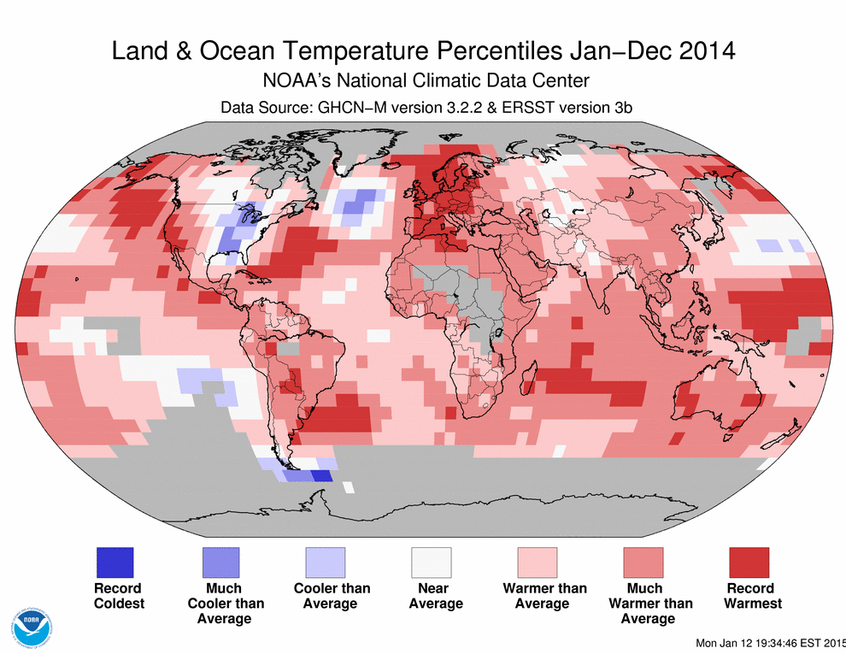

Slide 27
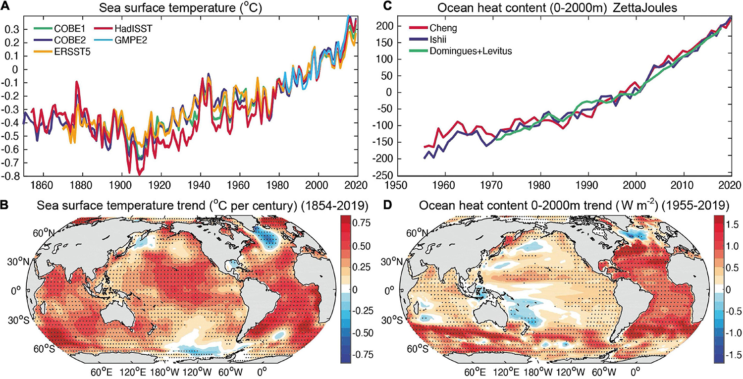
Observed SST Changes 1854-2020

Slide 28
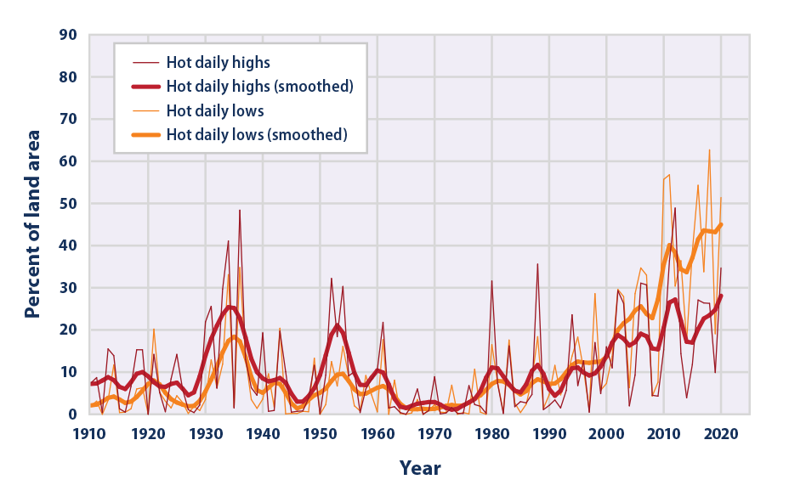
Area of the US with Unusually Hot Summer Temperatures, 1910–2020
EPA 2023

Slide 29
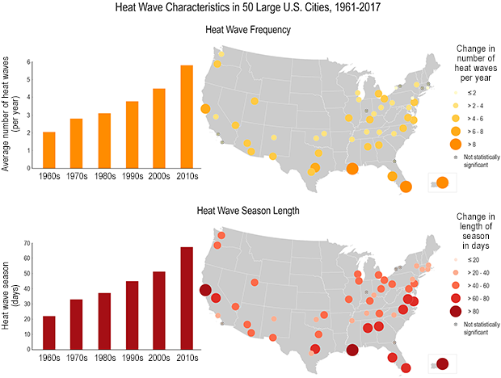
Trends in Heat Waves in the US
United States Global Change Research Program

Slide 30
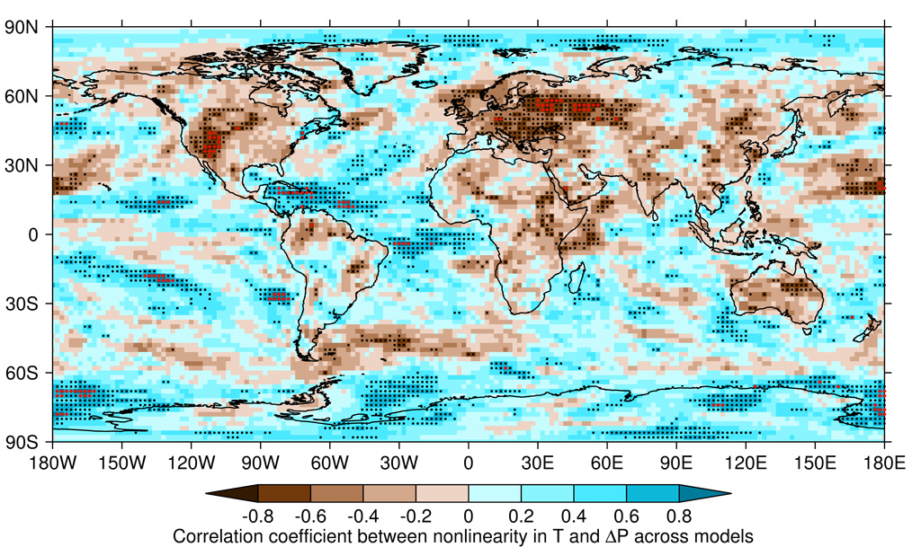
Drought and Warming - Dry regions that get drier, will also likely see accelerated local warming
King (2019) Environmental Research Letters

Slide 31
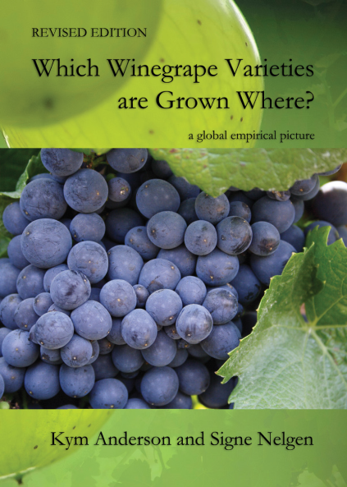
Climate Change and Grapevine Diversity
Roughly 5000 unique V. Vinifera varieties are grown worldwide
Wine Grape (Robinson et al.) identifies 1368 commercially grown ‘prime’ varieties
Concentration of varieties has increased, 50% of the world’s plantings are now done with 16 varieties
New world wine regions, 7 varieties make up 50% of the plantings
1990-2020

